Slide 1
STUDENT HIVE
CS 691 – Computer Science Capstone Project

Slide 2
Agenda
Team Members & Roles
Problem Statement
Project Description
Personas
Technologies & Algorithms
Team Working Agreement
Retrospective

Slide 3
INTRODUCTION

Slide 4
AGENDA
Review progress towards project deadlines and milestones and discuss any delays or challenges encountered and identify solutions.
Ensure alignment on the development progress and tasks completed and address any roadblocks hindering development and strategize solutions.
Mark important submission dates and deadlines for the project deliverables on the shared excel sheet with everyone's schedules.
Review presentation topics to ensure they align with project goals and discuss iterative updates to the presentation and delegate tasks accordingly.
Brainstorm and study through personas to understand client requirements thoroughly and Identify and prioritize the necessary features and functionalities from the client's perspective.
Discuss potential risks associated with the project and their impact and Strategize mitigation plans to address identified risks effectively.
Emphasize the importance of interaction, attendance, cooperation, teamwork and discuss the significance of individual contributions and attention to detail for project success.
Sync on the next steps for development, including task assignments, deadlines and Outline action items and responsibilities for each team member.
Recap key discussion points and action items also confirm the date and time for the next meeting, if necessary and ensure open communication and collaboration among team members.

Slide 5
Team Members & Roles

Slide 6

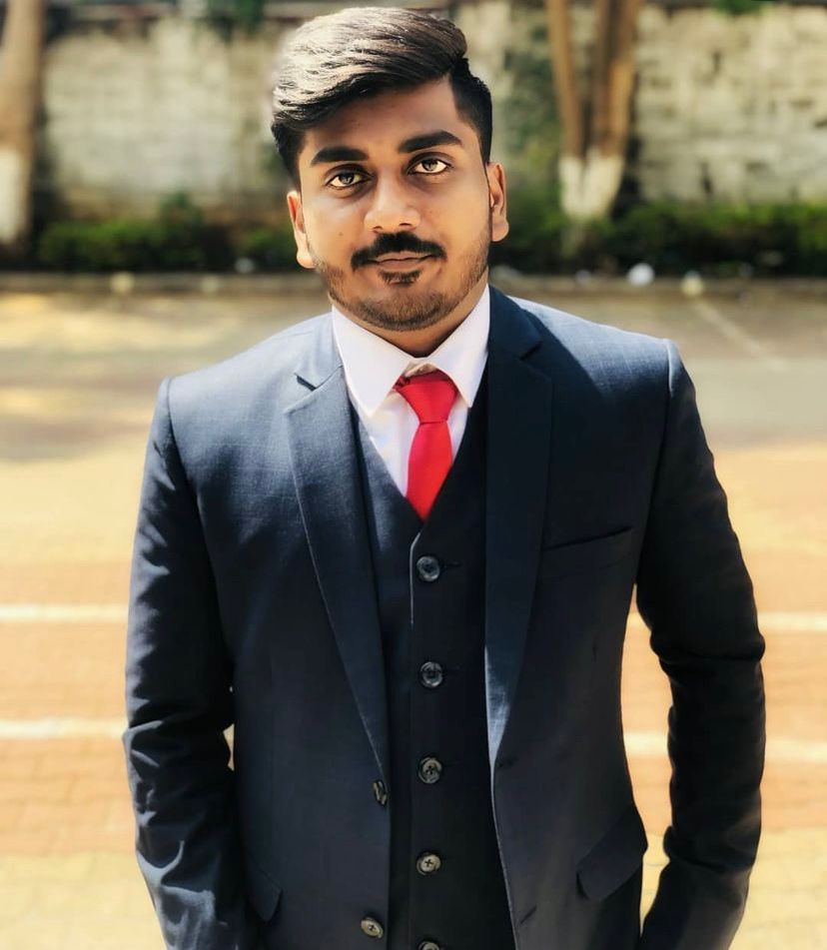


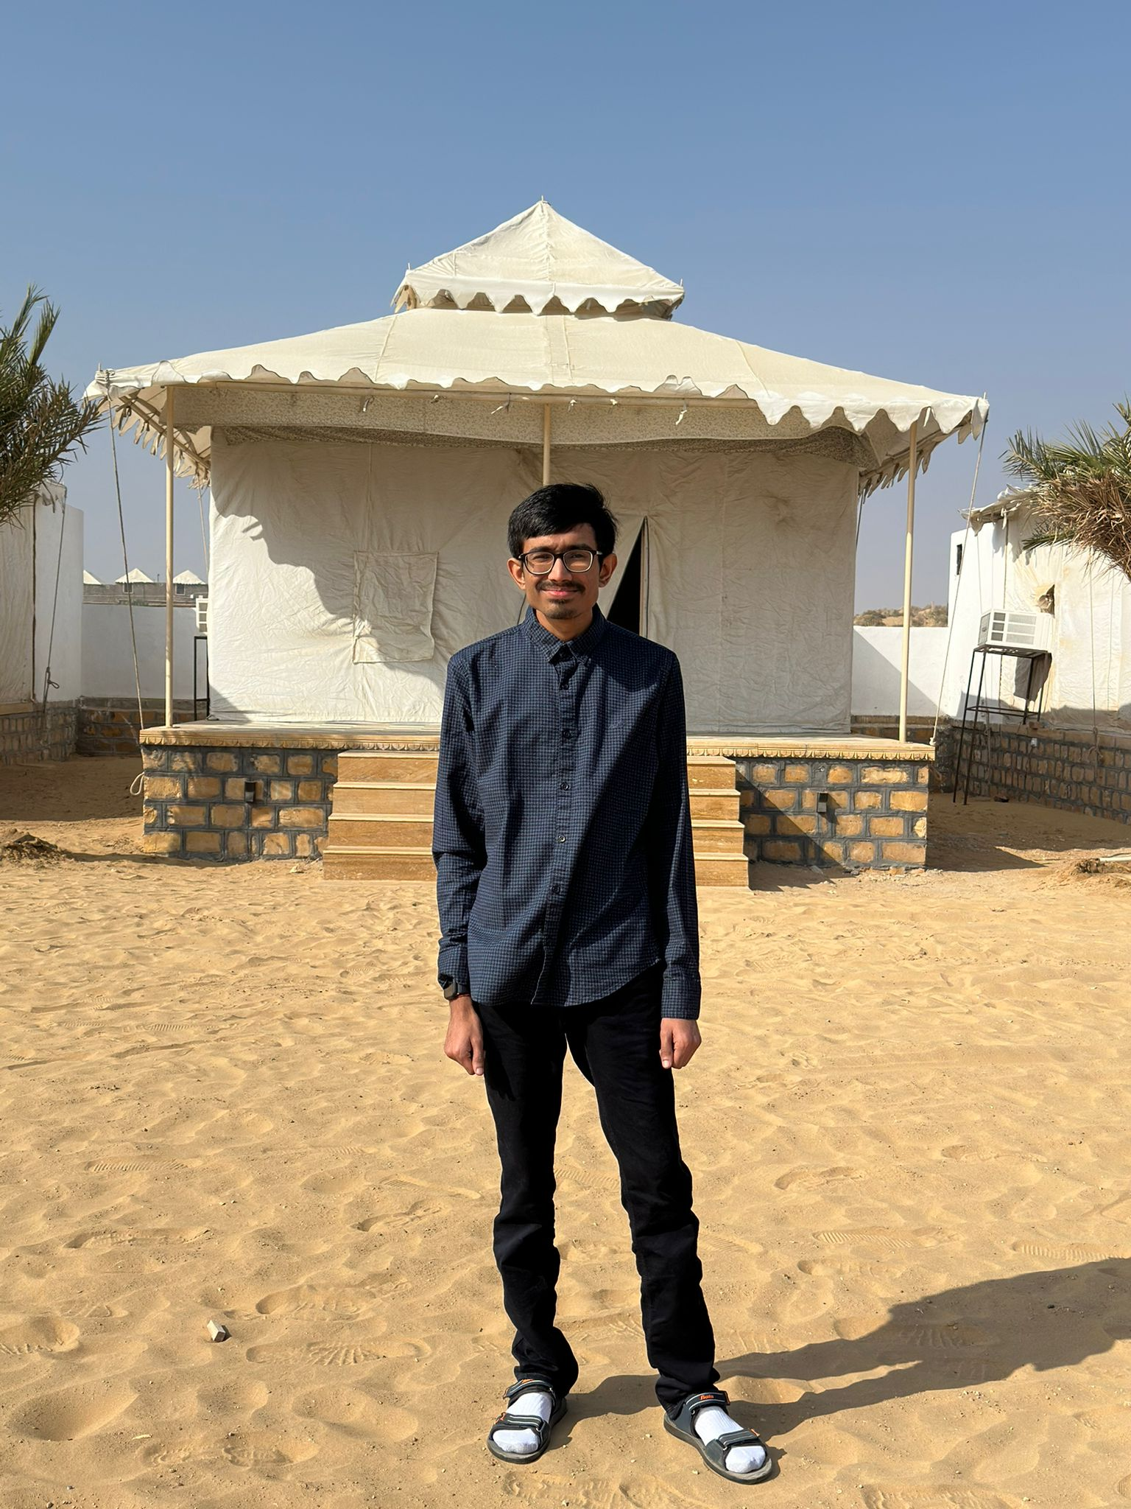
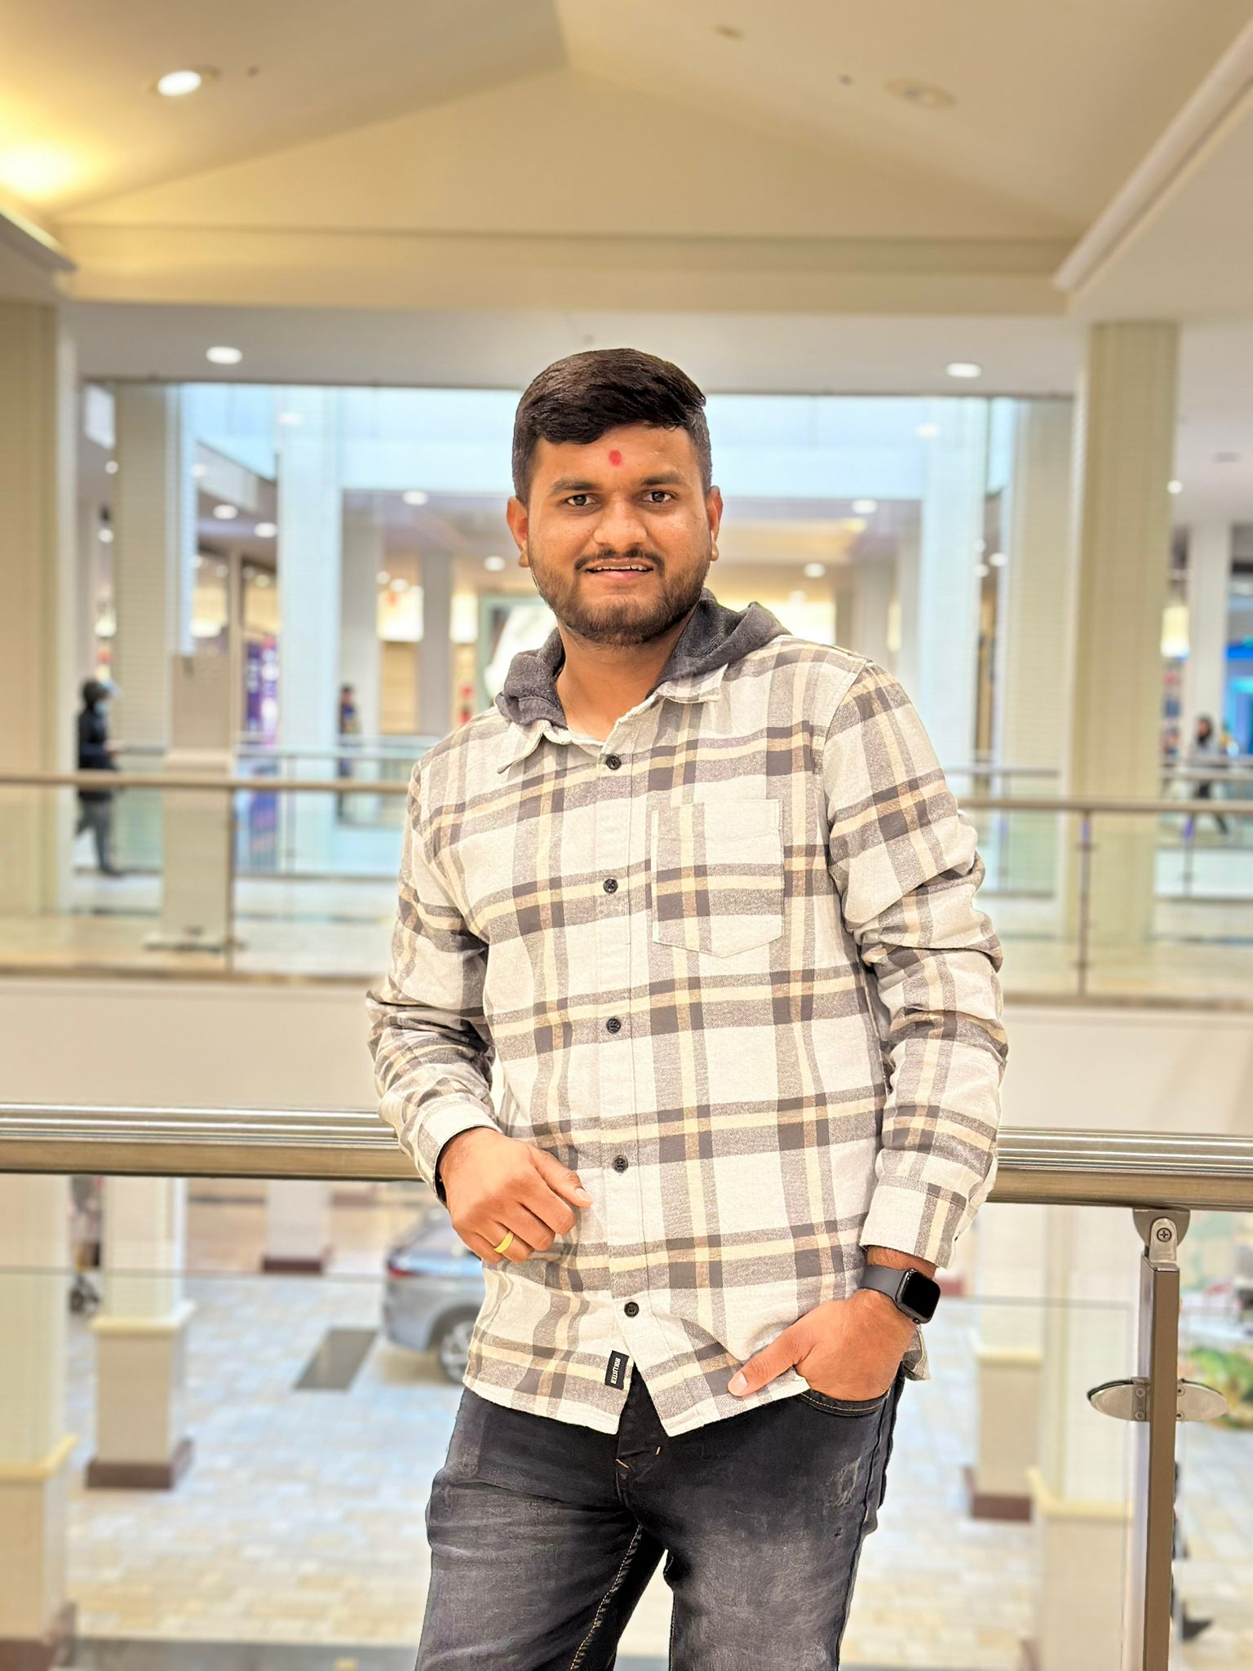
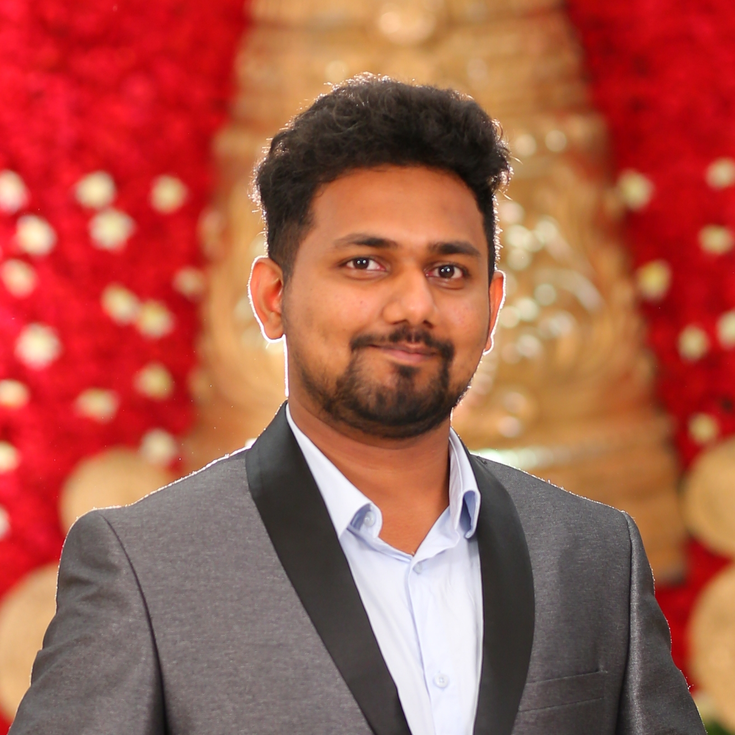
MEET OUR TEAM
SMIT
SUJAN SIDDARTH
KIRAN KUMAR
YASHKUMAR
FRONT END DEVELOPER
TESTER
FULL STACK DEVELOPER
DATABASE ADMINSTRATOR
PARTH
SIDDHARTHKUMAR
RAJ KOUSHIK
PROJECT MANAGER
DATA ANALYST
FULL STACK DEVELOPER

Slide 7
PROBLEM STATEMENT

Slide 8
PROBLEM STATEMENT
In the current landscape of student housing, there exists a lack of secure and convenient platforms tailored specifically to the needs of students seeking shared living arrangements. Many students struggle to find reliable and trustworthy accommodation options that align with their preferences, leading to frustration and uncertainty in their housing search. Additionally, the absence of comprehensive resources such as transportation information and nearby amenities further complicates the process, leaving students feeling overwhelmed and disconnected from their potential living environments. As a result, there is a pressing need for a solution that addresses these challenges and provides students with a seamless and empowering experience in finding suitable accommodation.

Slide 9
PROJECT DESCRIPTION

Slide 10
PROJECT DESCRIPTION
"Student Hive" is a secure and convenient platform designed for students seeking shared living arrangements. By registering with their school email, users gain access to comprehensive listings tailored to their accommodation preferences and budgeting needs. Advanced search options and communication tools facilitate connections with potential roommates or landlords, while additional resources such as transportation information and nearby amenities enhance the overall living experience. With support and community engagement features available, "Student Hive" empowers students to confidently navigate their search and find the perfect accommodation suited to their needs.

Slide 11
PERSONAS

Slide 12

Persona 1: Emily, Budget-Conscious Student
Emily is a graduate student studying environmental science, deeply passionate about sustainable living and outdoor activities. To manage her finances while attending university, she searches for affordable housing options on Zillow, prioritizing rentals close to campus to minimize commute times and reduce her carbon footprint. She seeks roommates to share expenses, emphasizing the importance of access to public transport and local amenities like grocery stores that support her eco-friendly lifestyle. Emily's ideal home is a place where she can easily walk to campus, have space to grow her small container garden, and live comfortably within her budget.

Slide 13

Persona 2: Alex, Intern/Co-op Seeker
Alex is an undergraduate computer science student preparing for a summer tech internship in a new city. An avid coder and part-time gamer, Alex looks for short-term, furnished housing on Zillow that aligns with the duration of his internship. He values properties that are move-in ready and close to his workplace or well-connected by public transport, enabling him to focus on his professional development and explore his interests in tech meetups. Alex's search is driven by the need for flexibility, affordability, and a hassle-free living situation that supports his busy internship schedule.

Slide 14
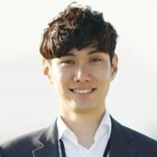
Persona 3: Jordan, Graduate Student/Young Professional
Jordan, recently graduated with a degree in marketing, is transitioning into the professional world while considering graduate studies. As an enthusiastic amateur photographer and social media aficionado, Jordan uses Zillow to find a living space that strikes a balance between work, study, and leisure, in a neighborhood popular among young professionals and students. She looks for rentals that offer quiet study areas, proximity to cafes and co-working spaces, and access to vibrant social scenes. Jordan's ideal housing solution combines affordability with the convenience of urban living, reflecting her ambition and lifestyle.

Slide 15
Technologies & Algorithms

Slide 16
TECHNOLOGIES
Front End
React, Oauth2.0, TanStack Query(Context API - State Management), Axios, Zod (Validation)
Back End
Node JS, Fastify, MongoDB, Passport JS(Auth), Mongoose (ORM)
ALGORITHMS
KNN, Linear Regression

Slide 17
TEAM WORKING AGREEMENT

Slide 18
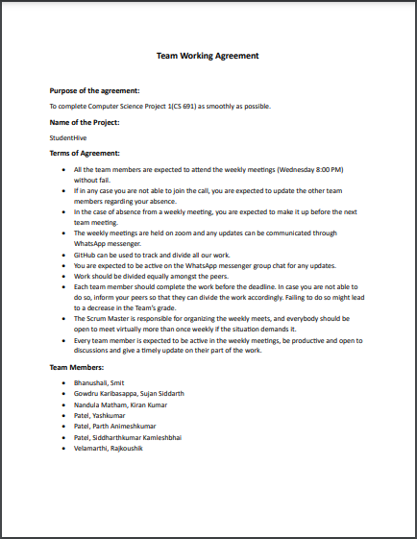

Slide 19
RETROSPECTIVE

Slide 20
What helped us move forward
Effective communication facilitated a thorough grasp of the project objectives.
Collaborative teamwork streamlined the process of gathering requirements.
We've compiled a list of technologies to employ, though there remains a need for deeper comprehension to ensure the development of a high-quality product.

Slide 21
What held us back
Meeting scheduling necessitates meticulous planning.
Need to plan a backup when we encounter unexpected circumstances. In our case, Team member falling sick.
There's room for enhancement in team participation levels.

Slide 22
What should we do next
Schedule a thorough discussion on time availability to ensure proper coordination.
Clarify deadlines to ensure tasks are completed according to the schedule.
Begin working on the assigned activities promptly.

Slide 23
How could we do things differently
Transition from using WhatsApp group chat to utilizing the Discord more frequently. This will provide exposure to office communication practices and the applications commonly used in professional settings.
Foster a culture of mutual support and motivation within the team, allowing individuals who may lack certain skills the space and encouragement to learn and improve.

Slide 24
WIKIPAGE LINK
https://github.com/rajkoushikv/studenthive/wiki/Wikipage

Slide 25
THANK YOU

